Slide 1

Global Cost vs Value of Higher Education
Fahad Bin Gias| Data Talent Capstone | May 2025

Slide 2

Introduction
Problem Statement
International students often make decisions based on rankings or reputation, but often overlook hidden cost structures. This analysis explores affordability, value, and ROI across 900+ programs in 40+ countries.

Slide 3
Dataset Overview
This analysis focuses on 907 programs across 40+ countries from the Cost of Education dataset.
QS and Salary datasets were used to enrich fields
Key analysis fields include: Total cost, Degree level, Program name, QS rank, and ROI estimates.
Dataset | Description | Key Fields | Source
Cost of International Education | Tuition, living, visa, insurance and other costs | Country, City, Program, Tuition, Rent, Duration, Exchange Rate | Kaggle
QS Rankings | Rankings for 1,500 universities worldwide | University, Country, QS Rank | Kaggle
Global Salary Dataset | Monthly salaries in USD for 222 countries | Country, Avg_Income_USD | Kaggle

Slide 4
Feature Engineering & Data Quality
Total Cost = Tuition + Rent + Insurance + Visa
Adjusted Cost = Living cost index adjusted
ROI = Total Cost / Avg Income
QS Rank integration + Prestige Tiers
KMeans clustering of cost structure
Outlier removal: 37 rows with z-score > 2 in Total Cost dropped

Slide 5
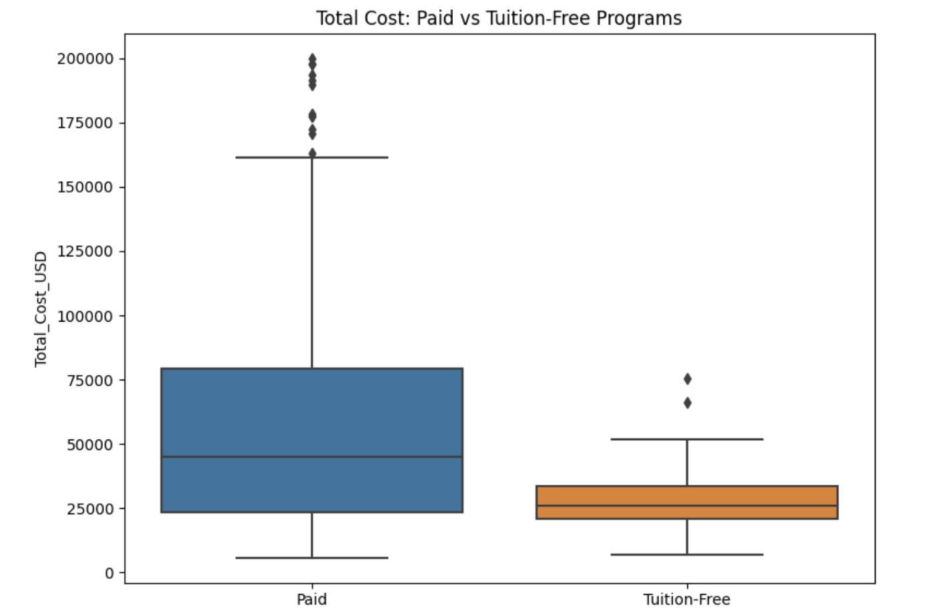
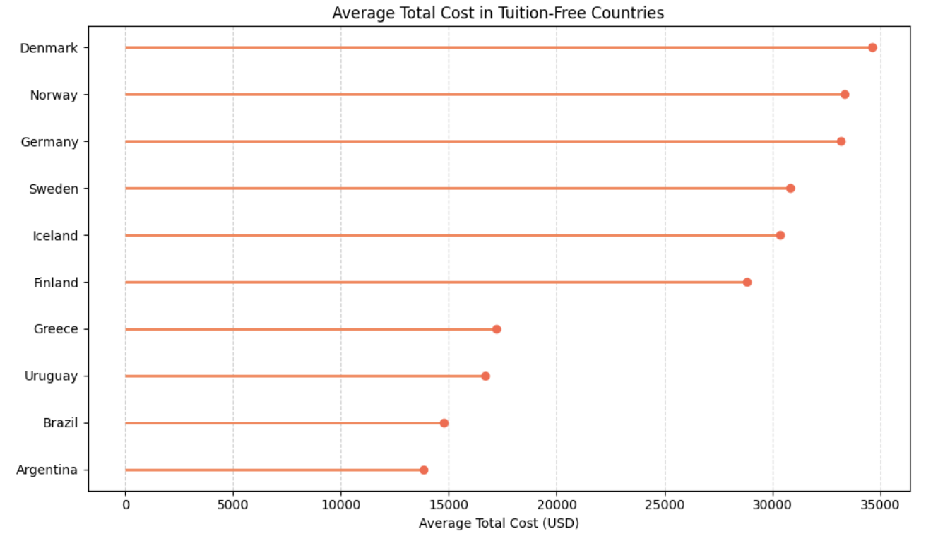
Tuition-Free ≠ Cost-Free
103 programs had $0 tuition
Median total cost still above $20K due to rent/insurance
Denmark, Norway, Germany, lead in tuition-free programs with high living costs

Slide 6
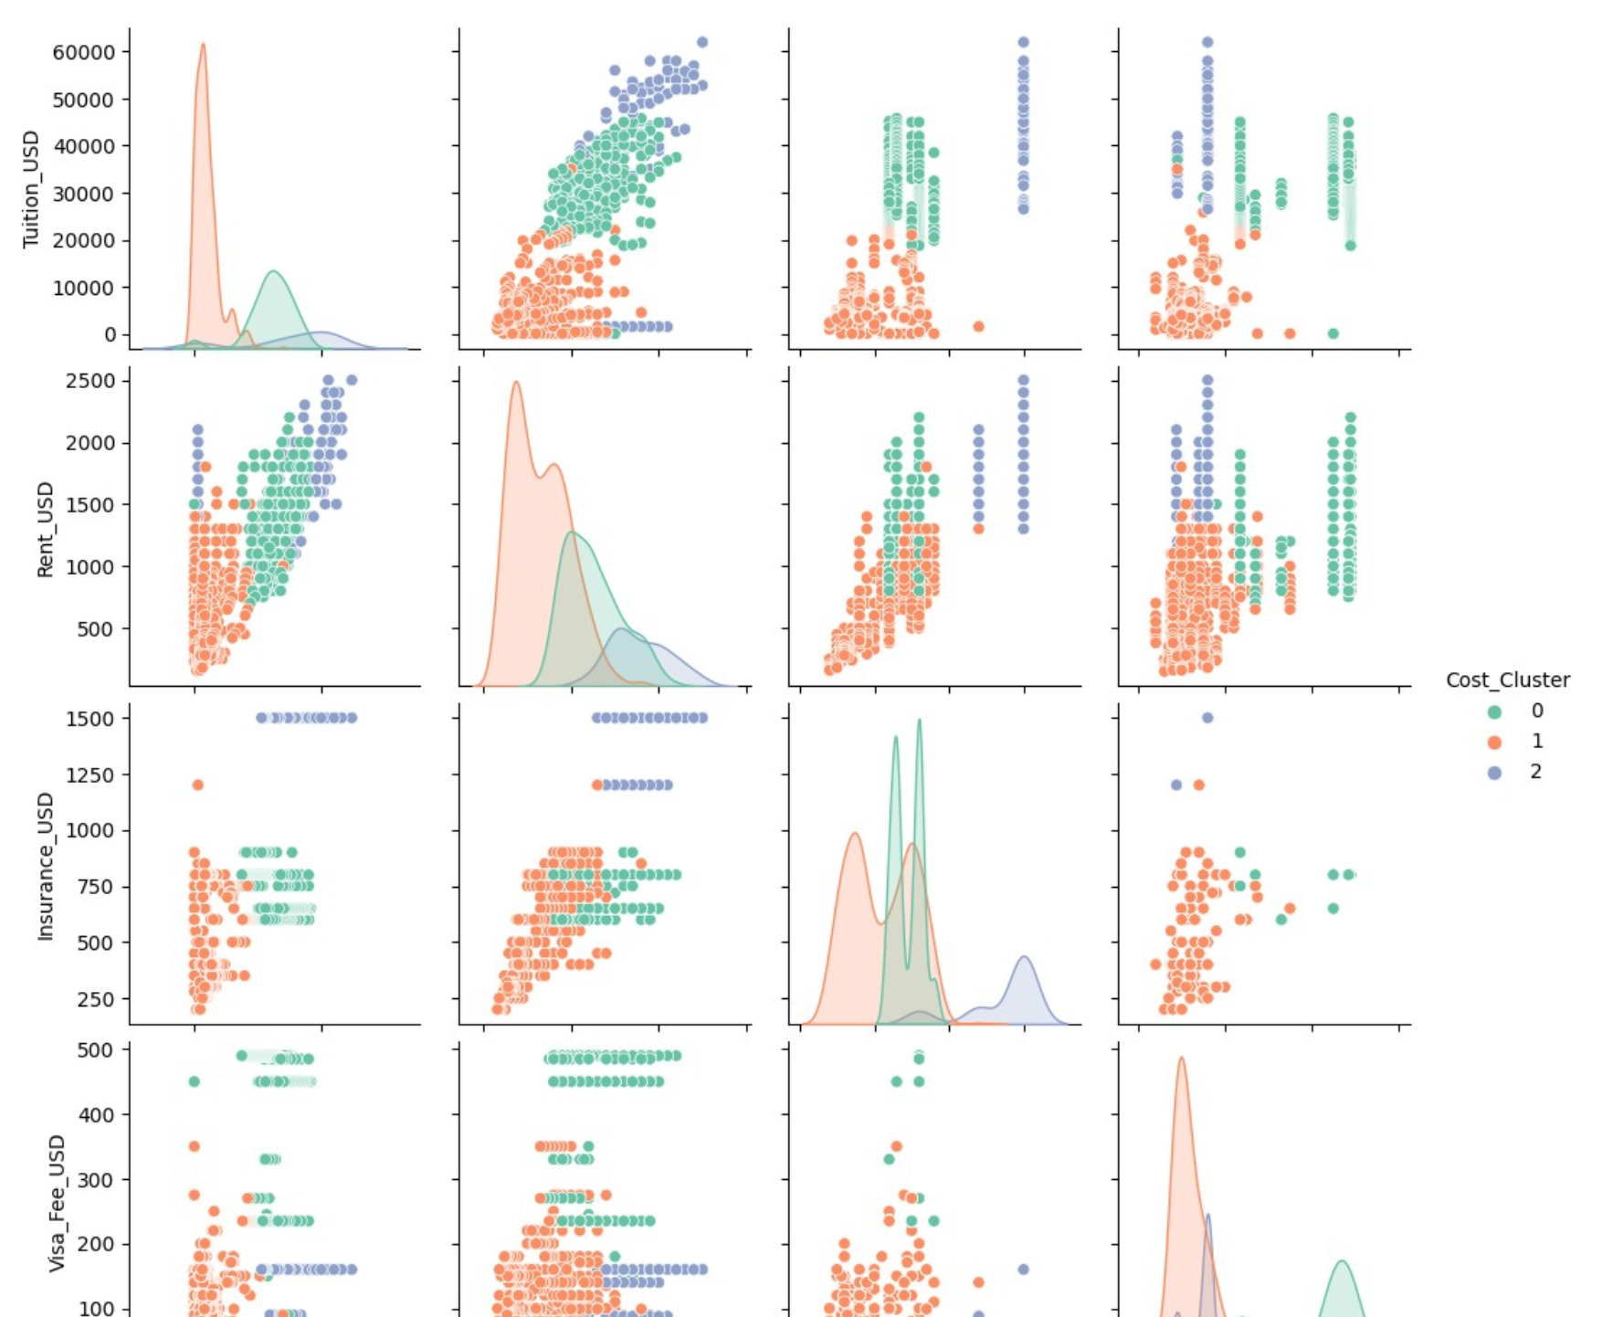
Global Cost Clusters (KMeans)
Cluster 0: Elite Expensive (US, UK)
Cluster 1: Budget (India, Tunisia, Bangladesh)
Cluster 2: Tuition-Free, High Rent (Nordics)

Slide 7
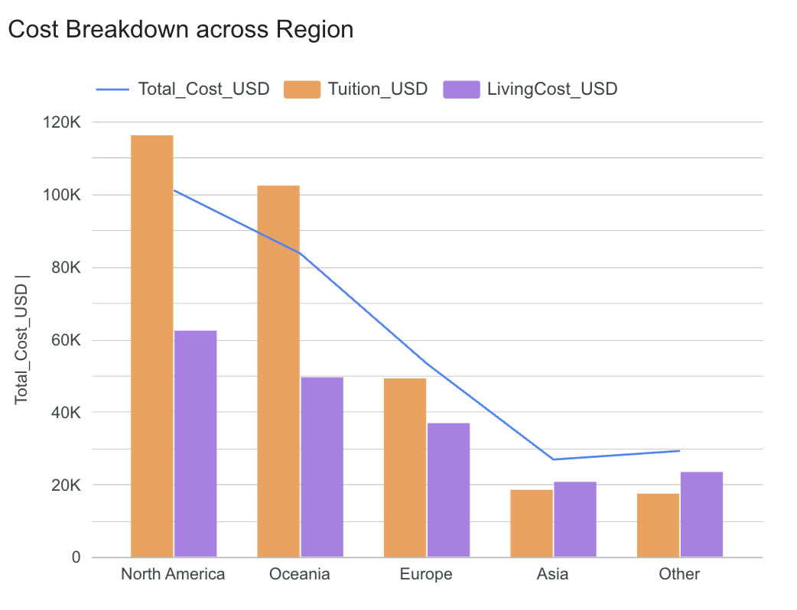
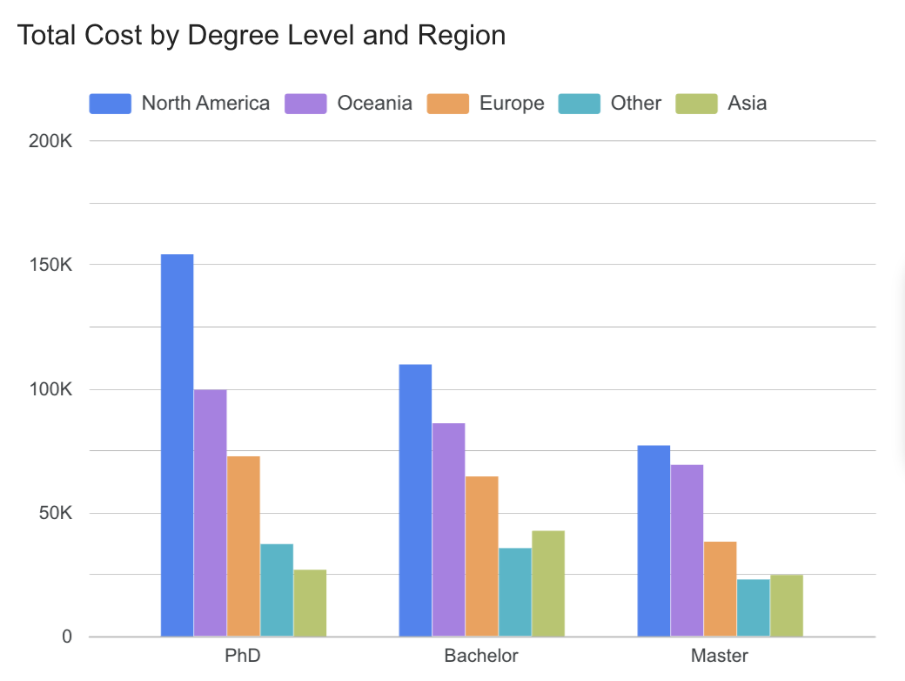
Regional & Degree Insights
Regional observations:
North America: Highest total cost, driven by tuition-heavy programs
Europe: Low or free tuition, offset by high living costs (especially for Master’s)
Asia: Most affordable overall, though cost variance is high
Oceania: High tuition and high living costs, comparable to North America
Degree-level observations:
Bachelor's programs in North America show the highest average cost
Master's degrees in Asia are generally the most affordable
PhDs often show lower costs due to funding and stipends

Slide 8
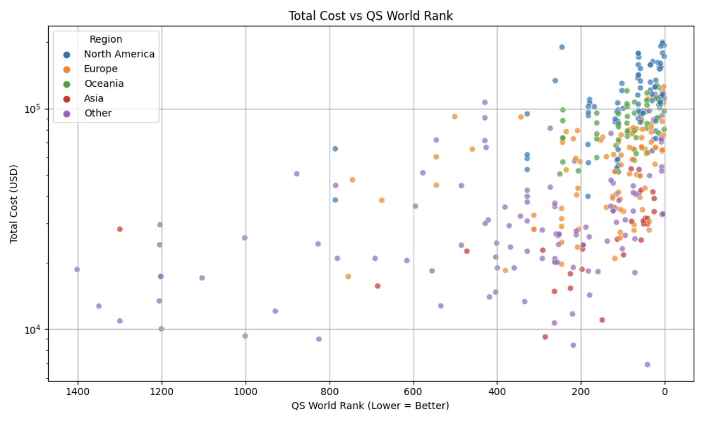
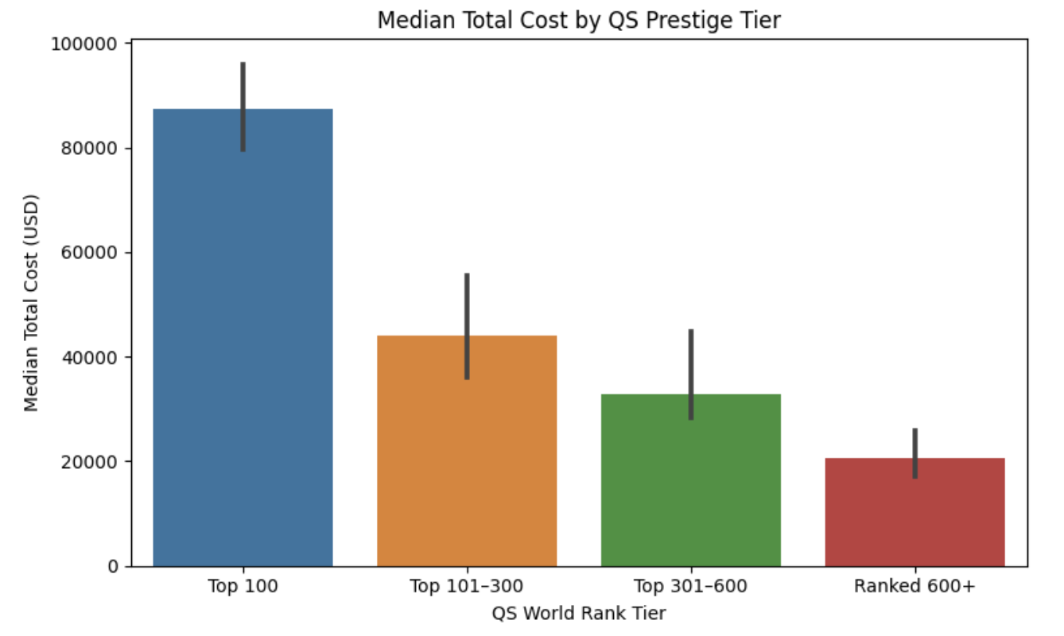
QS Rank vs Cost
Higher-ranked universities (Top 100) are associated with significantly higher total costs — nearly double those in lower tiers
Median cost drops consistently from Top 100 to Ranked 600+, showing a strong cost-prestige trade-off
South Asian engineering institutions offer exceptional value: India’s IITs (Top 200–600) and Bangladesh’s public engineering universities (Ranked 600+) deliver globally ranked programs for under $20K and under $15K respectively — balancing affordability with tiered prestige
This supports the insight: prestige comes at a premium, but value exists beyond the top ranks

Slide 9
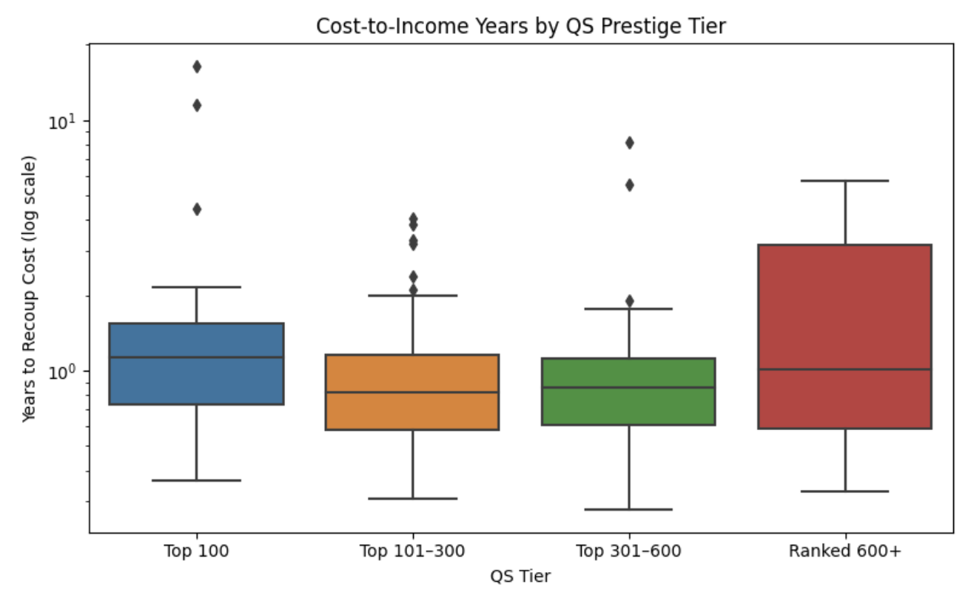
ROI by QS Prestige Tier
Top 301–600 universities offer the best ROI, with consistently low payback periods
Ranked 600+ institutions show the widest spread in ROI, indicating less predictable outcomes
Despite their prestige, Top 100 schools don’t guarantee faster ROI, often due to higher costs
Median ROI trends show that prestige doesn't always mean better value

Slide 10
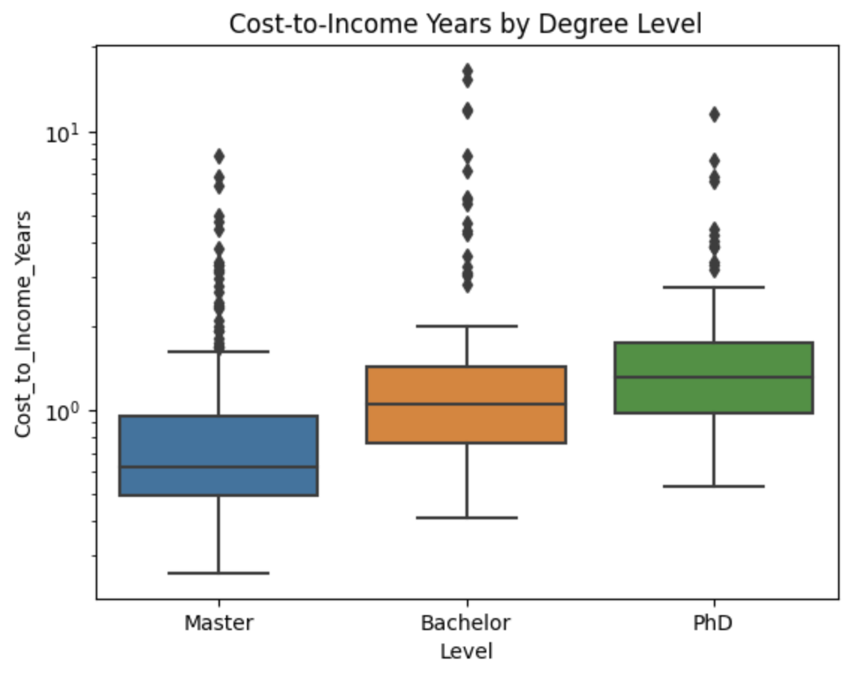
ROI by Degree Level
Master’s programs recover cost faster than Bachelor’s or PhDs on average
Bachelor’s degrees show wider ROI range depending on location and tuition
PhDs show slower ROI due to longer duration — unless fully funded

Slide 11
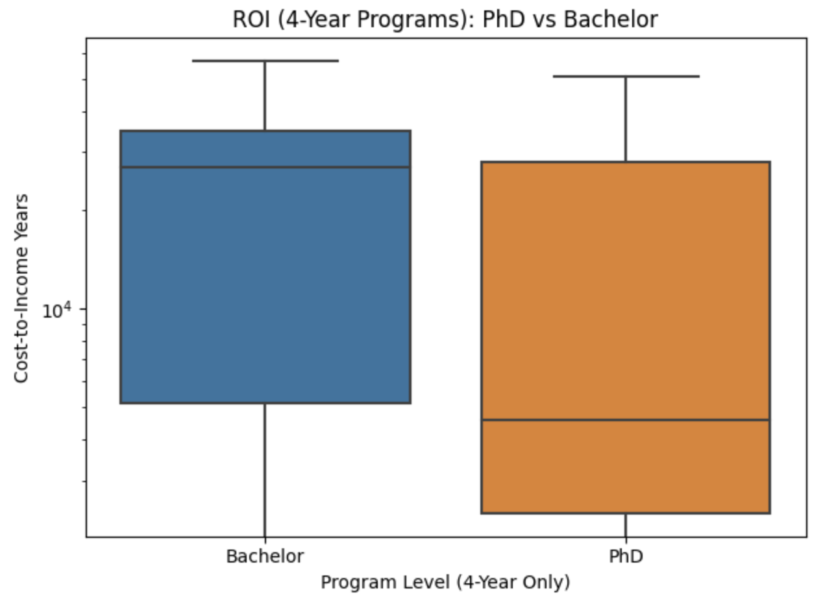
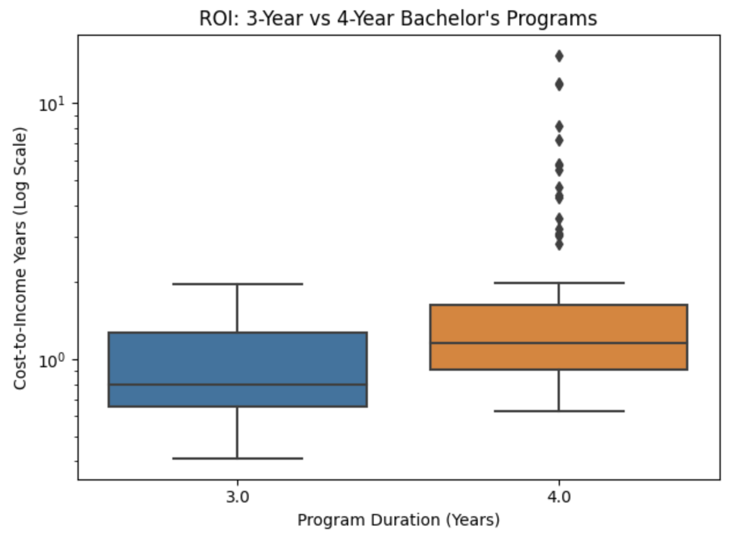
ROI in Bachelor’s vs PhD
3-Year Bachelor's programs (Europe) recover cost faster than 4-Year tracks (US/Canada), which show more variability and outliers
PhD programs (4-Year) generally outperform 4-Year Bachelor's in ROI due to waived tuition and stipend support
Highlights the cost-efficiency of shorter degrees and the value of fully funded graduate education

Slide 12
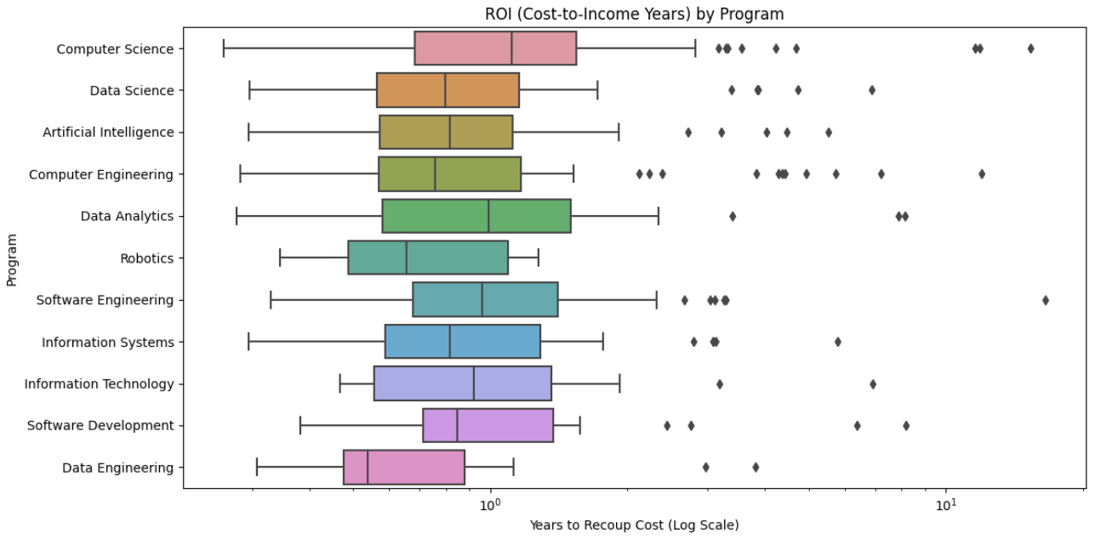
ROI by Program (CS/Tech)
Best ROI: Data Engineering, Robotics, Computer Engineering
Higher variance: Data Analytics, AI, Software Engineering
Based on most represented fields (CS/Data focused)

Slide 13
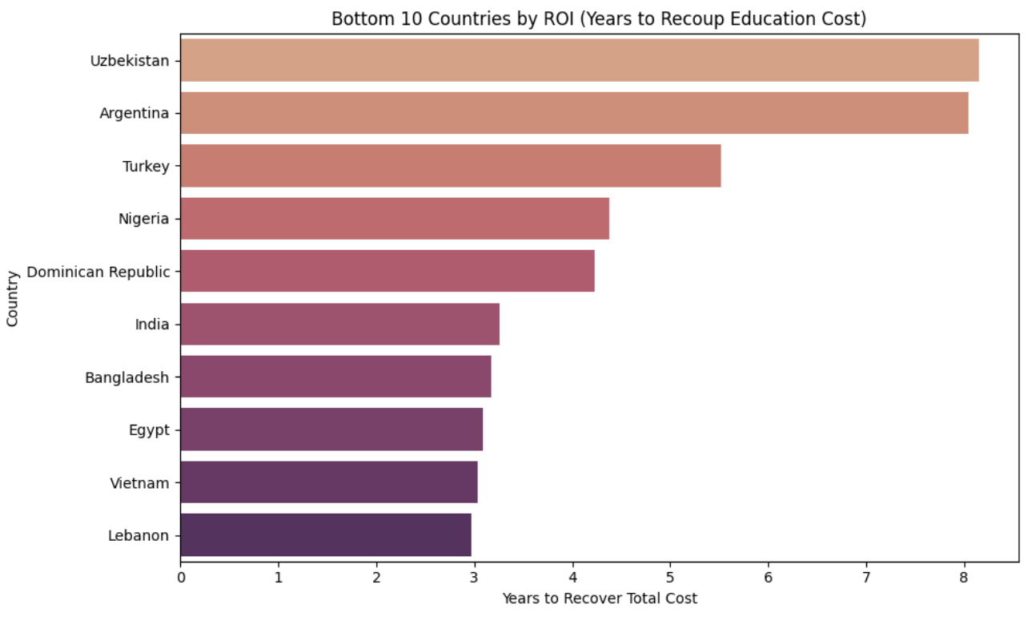
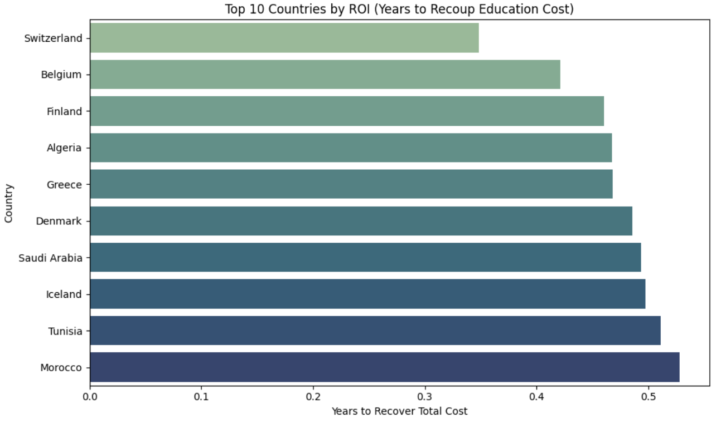
Global ROI Extremes
Fastest vs Slowest Recovery Countries
European and MENA countries lead global ROI rankings, driven by generous public funding, low tuition, and strong graduate earnings. Nations such as Switzerland, Belgium, and Finland (Europe), and Saudi Arabia, Morocco, and Tunisia (MENA) enable students to recover education costs in under 6 months.
South Asian countries like India and Bangladesh show moderate ROI despite low tuition, due to limited salary growth and slower income recovery. While these countries offer strong value per rank, their limited earning potential reduces overall financial returns.
Latin American and Sub-Saharan African nations face the slowest ROI, often taking 5–8 years to break even—due to economic volatility and weak income-to-cost alignment.
These patterns underscore the need to evaluate both affordability and earning potential when assessing the true return on education.

Slide 14
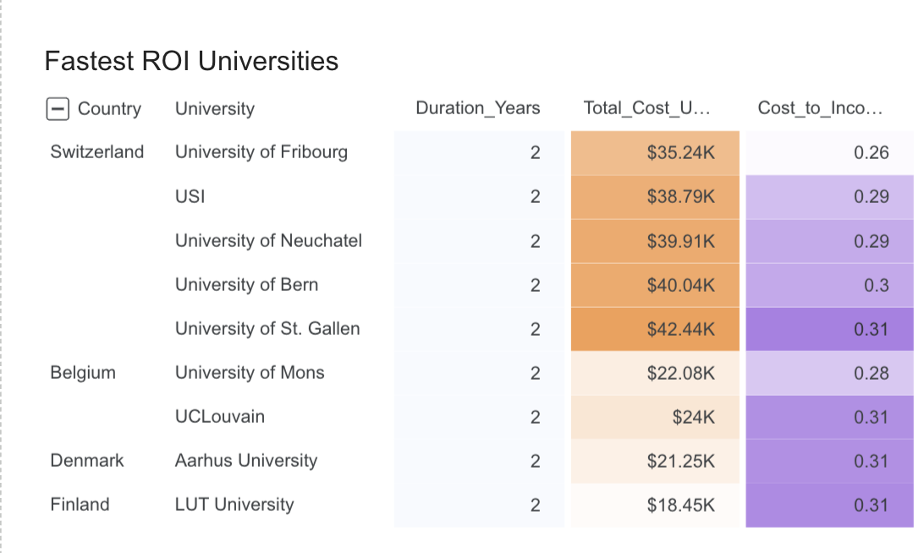
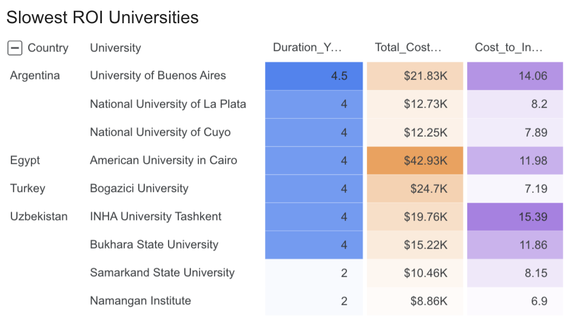
University-Level ROI Extremes
Fastest and Slowest Payback Institutions
Top ROI universities are concentrated in Western and Northern Europe, particularly in Switzerland, Belgium, Finland, and Denmark.
Examples: University of Fribourg, USI, LUT University, UCLouvain
Students recover education costs in under 0.32 years (≈ 4 months), driven by moderate tuition and strong post-graduation income.
Bottom ROI universities are clustered in Latin America, Central Asia, and North Africa, with the highest delays observed in Argentina, Uzbekistan, and Egypt.
Examples: University of Buenos Aires, INHA University Tashkent, American University in Cairo
ROI recovery stretches 7 to over 16 years, reflecting longer program durations and limited earning potential.
These patterns reinforce a key insight: ROI depends not only on cost or prestige, but also on regional income dynamics and the efficiency of the education system.

Slide 15

Final Recommendations
Prestige comes at a premium — but Top 300–600 universities often deliver stronger ROI than Top 100
Shorter programs (3-year Bachelor's, funded PhDs) offer faster cost recovery without sacrificing quality
South Asia (India, Bangladesh) provides top cost-per-rank value, while Europe and MENA lead global ROI due to public funding and stronger graduate income
High ROI depends on regional income potential, not just affordability — students should consider cost and earnings after graduation
Top tech fields for ROI: Data Engineering, Robotics, and Computer Engineering
Use the Interactive Dashboard to filter by country, QS tier, duration, and ROI — and find your best-fit academic investment

Slide 16
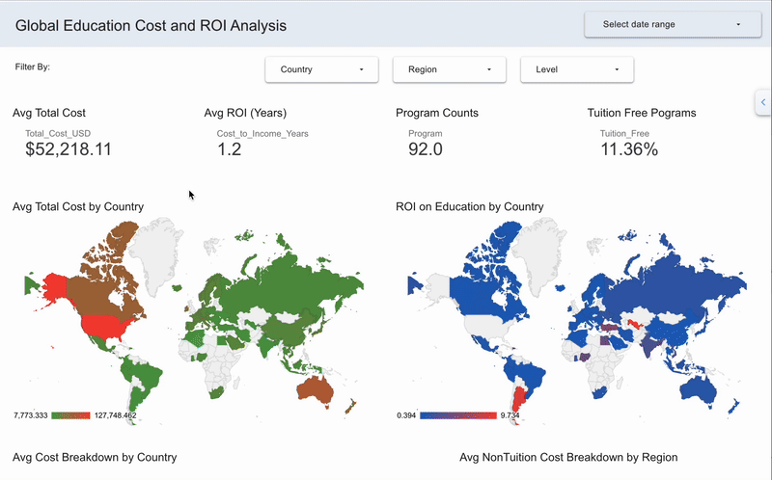
A Glimpse into the Dashboard

Slide 17

Explore Further & Stay Connected
📁 GitHub Repository Full notebook, cleaned datasets, and presentation materials
📊 Interactive Dashboard (Looker Studio) Filter by country, QS tier, degree level, and ROI to explore programs that fit your goals
Thank You
This project supports students, institutions, and advisors in making informed, ROI-focused academic decisions.
For collaborations or feedback, feel free to connect on LinkedIn or GitHub.
Looking Ahead:
ROI modeling by career path & post-grad salary
Business & non-STEM program integration
Migration-adjusted ROI insights

